Slide 1
BCSE102L Structured and Object-Oriented Programming

Slide 2
Outline
Structures [Kochan, chap 9]
  Defining and using Structures
  Functions and Structures
  Initializing Structures. Compound Literals
  Arrays of Structures
  Structures Containing Structures and/or Arrays
More on Data Types [Kochan, chap 14]
  Enumerated Data Types
  The typedef Statement
  Data Type Conversions

Slide 3
The concept of structures
Structure: a tool for grouping heterogenous elements together.
Array: a tool for grouping homogenous elements together
Example: storing calendar dates (day, month, year)
Version1: using independent variables:
int month = 9, day = 25, year = 2004;
Using this method, you must keep track of three separate variables for each date that you use in the program—variables that are logically related. It would be much better if you could somehow group these sets of three variables together. This is what the structure in C allows you to do !

Slide 4
Example: structures
struct date
{
  int month;
  int day;
  int year;
};
Defines type struct date, with 3 fields of type int
The names of the fields are local in the context
of the structure.
A struct declaration defines a type: if not followed by a
list of variables it reserves no storage; it merely
describes a template or shape of a structure.
struct date today, purchaseDate;
Defines 3 variables of
type struct date
today.year = 2004;
today.month = 10;
today.day = 5;
Accesses fields of a variable of
type struct date
A member of a particular structure is referred to
in an expression by a construction of the
form structurename.member

Slide 5
Example: determine tomorrow’s date (Version 1)
// Program to determine tomorrow's date
#include <stdio.h>
int main (void)
{
  struct date
  {
    int month;
    int day;
    int year;
  };
  struct date today, tomorrow;
  const int daysPerMonth[12] = { 31, 28, 31, 30, 31, 30,
  31, 31, 30, 31, 30, 31 };
  printf ("Enter today's date (mm dd yyyy): ");
  scanf ("%i%i%i", &today.month, &today.day, &today.year);

Slide 6
Example continued
if ( today.day != daysPerMonth[today.month - 1] ) {
  tomorrow.day = today.day + 1;
  tomorrow.month = today.month;
  tomorrow.year = today.year;
}
else if ( today.month == 12 ) { // end of year
  tomorrow.day = 1;
  tomorrow.month = 1;
  tomorrow.year = today.year + 1;
}
else { // end of month
  tomorrow.day = 1;
  tomorrow.month = today.month + 1;
  tomorrow.year = today.year;
}
printf ("Tomorrow's date is %i/%i/%i.\n", tomorrow.month,
tomorrow.day, tomorrow.year );
return 0;
}

Slide 7
Operations on structures
Legal operations on a structure are :
  copying it or assigning to it as a unit
    this includes passing arguments to functions and returning values from functions as well.
  taking its address with &
  accessing its members.
  structures may not be compared as units !
  a structure may be initialized by a list of constant member values

Slide 8
Example: determine tomorrow’s date (Version 2)
// Program to determine tomorrow's date
#include <stdio.h>
#include <stdbool.h>
struct date
{
  int month;
  int day;
  int year;
};
int numberOfDays (struct date d);
int main (void)
{
struct date today, tomorrow;
printf ("Enter today's date (mm dd yyyy): ");
scanf ("%i%i%i", &today.month, &today.day, &today.year);
Defines type struct date as a global type
Declares a function that takes a
struct date as a parameter

Slide 9
Example continued
if ( today.day != numberOfDays (today) ) {
  tomorrow.day = today.day + 1;
  tomorrow.month = today.month;
  tomorrow.year = today.year;
}
else if ( today.month == 12 ) { // end of year
  tomorrow.day = 1;
  tomorrow.month = 1;
  tomorrow.year = today.year + 1;
}
else { // end of month
  tomorrow.day = 1;
  tomorrow.month = today.month + 1;
  tomorrow.year = today.year;
}
printf ("Tomorrow's date is %i/%i/%i.\n",tomorrow.month,
tomorrow.day, tomorrow.year);
return 0;
}

Slide 10
Example continued
bool isLeapYear (struct date d);
// Function to find the number of days in a month
int numberOfDays (struct date d) {
  int days;
  const int daysPerMonth[12] = { 31, 28, 31, 30, 31, 30, 31, 31, 30, 31, 30, 31 };
  if ( isLeapYear (d) == true && d.month == 2 )
  days = 29;
  else
  days = daysPerMonth[d.month - 1];
  return days;
}
// Function to determine if it's a leap year
bool isLeapYear (struct date d) {
  bool leapYearFlag;
  if ( (d.year % 4 == 0 && d.year % 100 != 0) || d.year % 400 == 0 )
  leapYearFlag = true; // It's a leap year
  else
  leapYearFlag = false; // Not a leap year
  return leapYearFlag;
}

Slide 11
Example: determine tomorrow’s date (Version 3)
// Program to determine tomorrow's date
#include <stdio.h>
#include <stdbool.h>
struct date
{
  int month;
  int day;
  int year;
};
struct date dateUpdate (struct date today);
int main (void){
  struct date thisDay, nextDay;
  printf ("Enter today's date (mm dd yyyy): ");
  scanf ("%i%i%i", &thisDay.month, &thisDay.day,
  &thisDay.year);
  nextDay = dateUpdate (thisDay);
  printf ("Tomorrow's date is %i/%i/%i.\n",nextDay.month,
  nextDay.day, nextDay.year );
  return 0;
}
Declares a function that takes a
struct date as a parameter
and returns a struct date

Slide 12
Example continued
int numberOfDays (struct date d);
// Function to calculate tomorrow's date
struct date dateUpdate (struct date today) {
  struct date tomorrow;
  if ( today.day != numberOfDays (today) ) {
    tomorrow.day = today.day + 1;
    tomorrow.month = today.month;
    tomorrow.year = today.year;
  }
  else if ( today.month == 12 ) { // end of year
    tomorrow.day = 1;
    tomorrow.month = 1;
    tomorrow.year = today.year + 1;
  }
  else { // end of month
    tomorrow.day = 1;
    tomorrow.month = today.month + 1;
    tomorrow.year = today.year;
  }
  return tomorrow;
}

Slide 13
Example: Update time by one second
// Program to update the time by one second
#include <stdio.h>
struct time
{
  int hour;
  int minutes;
  int seconds;
};
struct time timeUpdate (struct time now);
int main (void) {
  struct time currentTime, nextTime;
  printf ("Enter the time (hh:mm:ss): ");
  scanf ("%i:%i:%i", &currentTime.hour, &currentTime.minutes,
  &currentTime.seconds);
  nextTime = timeUpdate (currentTime);
  printf ("Updated time is %.2i:%.2i:%.2i\n", nextTime.hour,
  nextTime.minutes, nextTime.seconds );
  return 0;
}

Slide 14
Example continued
// Function to update the time by one second
struct time timeUpdate (struct time now) {
  ++now.seconds;
  if ( now.seconds == 60 ) { // next minute
  now.seconds = 0;
  ++now.minutes;
  if ( now.minutes == 60 ) { // next hour
  now.minutes = 0;
  ++now.hour;
  if ( now.hour == 24 ) // midnight
  now.hour = 0;
  }
  }
  return now;
}
Parameters of a struct type are passed by copy of value

Slide 15
Initializing structures. Compound literals
struct date today = { 7, 2, 2005 };
struct time this_time = { 3, 29, 55 };
today = (struct date) { 9, 25, 2004 };
today = (struct date) { .month = 9, .day = 25, .year = 2004 };

Slide 16
Arrays of structures
struct time { . . . };
struct time timeUpdate (struct time now);
int main (void) {
  struct time testTimes[5] =
  { { 11, 59, 59 }, { 12, 0, 0 }, { 1, 29, 59 },
  { 23, 59, 59 }, { 19, 12, 27 }};
  int i;
  for ( i = 0; i < 5; ++i ) {
  printf ("Time is %.2i:%.2i:%.2i", testTimes[i].hour,
  testTimes[i].minutes, testTimes[i].seconds);
  testTimes[i] = timeUpdate (testTimes[i]);
  printf (" ...one second later it's %.2i:%.2i:%.2i\n",
  testTimes[i].hour, testTimes[i].minutes,
  testTimes[i].seconds);
  }
  return 0;
}

Slide 17
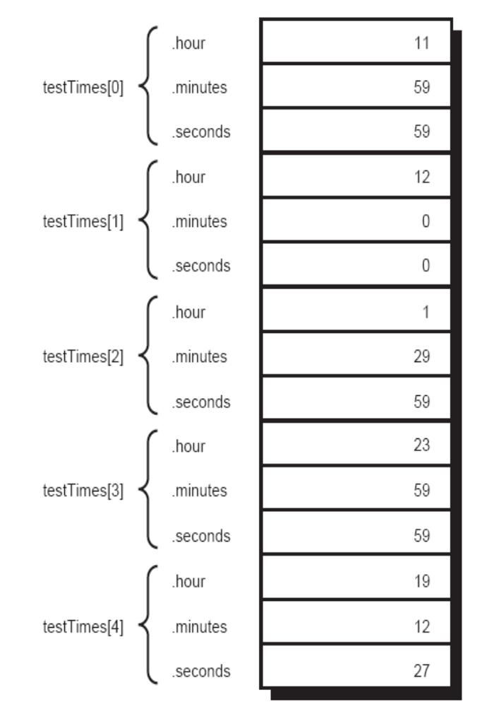

Slide 18
Structures containing structures
struct dateAndTime
{
  struct date sdate;
  struct time stime;
};
. . .
struct dateAndTime event;
event.sdate = dateUpdate (event.sdate);
event.sdate.month = 10;

Slide 19
Structures containing arrays
struct month
{
  int numberOfDays;
  char name[3];
};
struct month aMonth;
. . .
aMonth.numberOfDays = 31;
aMonth.name[0] = 'J';
aMonth.name[1] = 'a';
aMonth.name[2] = 'n';

Slide 20
Enumerated data type
You can use the enumerated type to declare symbolic names to represent integer constants.
By using the enum keyword, you can create a new "type" and specify the values it may have.
Actually, enum constants are type int; therefore, they can be used wherever you would use an int.
The purpose of enumerated types is to enhance the readability of a program.
enum primaryColor { red, yellow, blue };
enum primaryColor myColor, gregsColor;
myColor = red;
if ( gregsColor == yellow ) …

Slide 21
Enumerated data type
The C compiler actually treats enumeration identifiers as integer constants. Beginning with the first name in the list, the compiler assigns sequential integer values to these names, starting with 0.
enum month thisMonth;
...
thisMonth = february;
the value 1 is assigned to thisMonth because it is the second identifier listed inside the enumeration list.
If you want to have a specific integer value associated with an enumeration identifier, the integer can be assigned to the identifier when the data type is defined. Enumeration identifiers that subsequently appear in the list are assigned sequential integer values beginning with the specified integer value plus 1. For example, in the definition
enum direction { up, down, left = 10, right };
an enumerated data type direction is defined with the values up, down, left, and right. The compiler assigns the value 0 to up because it appears first in the list; 1 to down because it appears next; 10 to left because it is explicitly assigned this value; and 11 to right because it appears immediately after left in the list.

Slide 22
Example: enum
// Program to print the number of days in a month
#include <stdio.h>
int main (void)
{
  enum month { january = 1, february, march, april, may, june,july, august, september, october, november, december };
  enum month aMonth;
  int days;
  printf (“Enter month number: “);
  scanf (“%i”, &aMonth);

Slide 23
Cont.
switch (aMonth ) {
      case january: case march: case may: case july:
      case august: case october: case december:
        days = 31; break;
      case april: case june: case september: case november:
        days = 30; break;
      case february:
        days = 28; break;
      default:
        printf (“bad month number\n”);
        days = 0; break;
}
if ( days != 0 )
printf (“Number of days is %i\n”, days);
if ( amonth == february )
printf (“...or 29 if it’s a leap year\n”);
return 0;
}

Slide 24
The typedef statement
C provides a capability that enables you to assign an alternate name to a data type. This is done with a statement known as typedef.
  typedef type_description type_name;
The statement
typedef int Counter;
defines the name Counter to be equivalent to the C data type int. Variables can subsequently be declared to be of type Counter, as in the following statement:
Counter j, n;
The C compiler actually treats the declaration of the variables j and n, shown in the preceding code, as normal integer variables.
The main advantage of the use of the typedef in this case is in the added readability that it lends to the definition of the variables.
the typedef statement does not actually define a new type—only a new type name.

Slide 25
The typedef statement
In forming a typedef definition, proceed as though a normal variable declaration were being made. Then, place the new type name where the variable name would normally appear. Finally, in front of everything, place the keyword typedef:
typedef char Linebuf [81];
defines a type called Linebuf, which is an array of 81 characters. Subsequently declaring variables to be of type Linebuf, as in
Linebuf text, inputLine;
  typedef struct
  {
  int month;
  int day;
  int year;
  } Date;
Date birthdays[100];

Slide 26
Data type conversions
Expressions: Operands and operators
Operands may be of different types; issue: how is the expression evaluated and what is the type of the result ?
sometimes conversions are implicitly made by the system when expressions are evaluated !
The C compiler adheres to strict rules when it comes to evaluating expressions that consist of different data types.
Essence of automatic conversion rules: convert “smaller” type to “bigger” type
Example: the case examined in lecture 2 was with the data types float and int: an operation that involved a float and an int was carried out as a floating-point operation, the integer data item being automatically converted to floating point.
the type cast operator can be used to explicitly dictate a conversion.

Slide 27
Rules for automatic conversions
If either operand is of type long double, the other is converted to long double, and that is the type of the result.
2. If either operand is of type double, the other is converted to double, and that is the type of the result.
3. If either operand is of type float, the other is converted to float, and that is the type of the result.
4. If either operand is of type _Bool, char, short int, or of an enumerated data type, it is converted to int.
5. If either operand is of type long long int, the other is converted to long long int, and that is the type of the result.
6. If either operand is of type long int, the other is converted to long int, and that is the type of the result.
7. If this step is reached, both operands are of type int, and that is the type of the result.
Example: f is defined to be a float, i an int, l a long int, and s a short
int variable: evaluate expression f * i + l / s

Slide 28
Sign extensions
Conversion of a signed integer to a longer integer results in extension of the sign (0 or 1) to the left;
  This ensures that a short int having a value of –5 will also have the value –5 when converted to a long int.
Conversion of an unsigned integer to a longer integer results in zero fill to the left.

Slide 29

Signed integer representation
The representation of negative numbers: Most computers represent such numbers using the two’s complement notation.
Using this notation, the leftmost bit represents the sign bit. If this bit is 1, the number is negative; otherwise, the bit is 0 and the number is positive. The remaining bits represent the value of the number.
The value w of an N-bit integer is given by the formula:

Slide 30
Two’s complement example
N=8
W= 11111011
W=(-1)*2⁷+1*2⁶+1*2⁵+1*2⁴+1*2³+0+1*2¹+1*2⁰ =-5

Slide 31
Two’s complement example
A convenient way to convert a negative number from decimal to binary:
  add 1 to the value
  express the absolute value of the result in binary
  and then “complement” all the bits; that is, change all 1s to 0s and 0s to 1s.
Example: convert -5 to binary:
  First 1 is added, which gives -4;
  Value 4 expressed in binary is 00000100
  Complementing the bits produces 11111011.

Slide 32
Signed & Unsigned types
If in an expression appear both signed and unsigned operands, signed operands are automatically converted to unsigned
Converting signed to unsigned:
  No change in bit representation
  Nonnegative values unchanged
  Negative values change into positive values !
  Example: int x=-5; unsigned int ux=(unsigned int) x; printf(“%ud \n”,ux); // 4294966*62
Conversion surprises:
int a=-5;
unsigned int b=1;
if (a>b) printf("a is bigger than b");
else if (a<b) printf("b is bigger than a");
else printf("a equals b");

Slide 33
Explicit conversions/casts
Rules:
  Conversion of any value to a _Bool results in 0 if the value is zero and 1 otherwise.
  Conversion of a longer integer to a shorter one results in truncation of the integer on the left.
  Conversion of a floating-point value to an integer results in truncation of the decimal portion of the value. If the integer is not large enough to contain the converted floating-point value, the result is not defined, as is the result of converting a negative floating-point value to an unsigned integer.
  Conversion of a longer floating-point value to a shorter one might or might not result in rounding before the truncation occurs.

